Slide 1
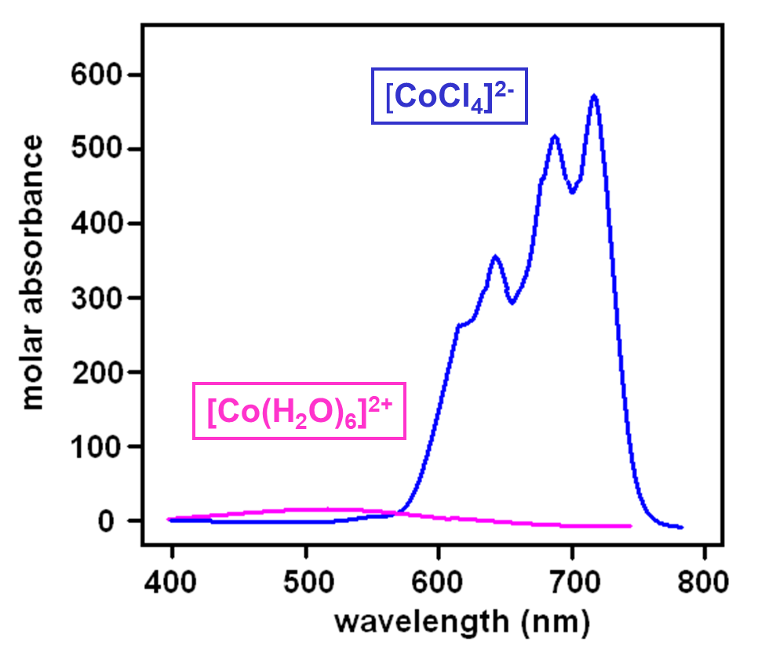

Case in Point: Tetrahedral vs Octahedral Complexes
As we have seen, a tetrahedron has no center of symmetry, and so orbitals in such symmetry cannot be gerade. Hence the d-levels in a tetrahedral complex are e and t₂, with no ‘g’ for gerade.
This largely overcomes the Laporte selection rules (enabled by d-p mixing), so that tetrahedral complexes tend to be more intense in color than octahedral.
Thus, we see that dissolving CoCl₂ in water produces a pale pink solution of [Co(H₂O)₆]²⁺, but in alcohol tetrahedral [CoCl₂(CH₃CH₂OH)₂] forms, which is a very intense blue color.

Slide 2
Representative Values of ε
Transition ε_{max} (M⁻¹cm⁻¹)
Spin and Symmetry forbidden "d-d" bands 0.001 - 1
Spin allowed and Symmetry forbidden "d-d" bands 1 - 100
Spin and Symmetry allowed CT bands 10³ - 5 x 10⁴
What are CT bands? CT refers to Charge Transfer transitions which are both
Laporte and Spin allowed and hence are very intense.
Certain complexes such as MnO₄⁻, CrO₄²⁻ etc. are intensely coloured even
though they have metal ions without electrons in the d-orbitals. The colour of these
complexes are not from d-d transitions, but from charge-transfer from ligand
to metal orbitals (LMCT).

Slide 3
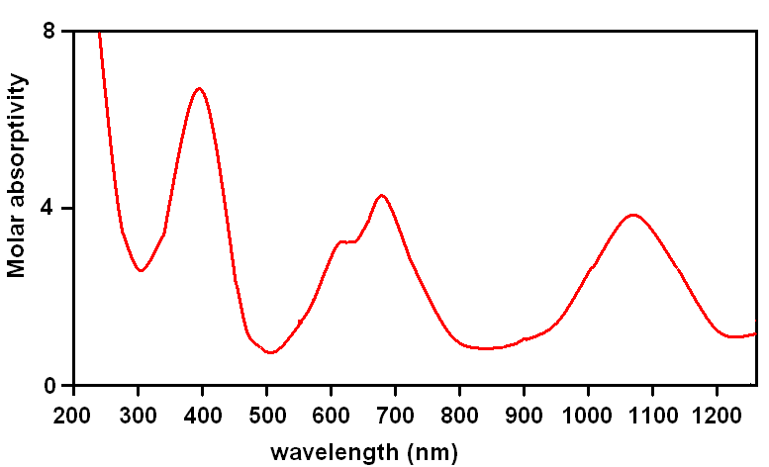
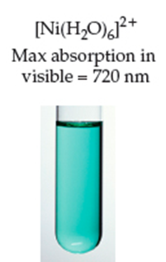
We May Not Be Able to “See” All Transitions
UV
visible
infrared
[Ni(H₂O)₆]²⁺
green

Slide 4
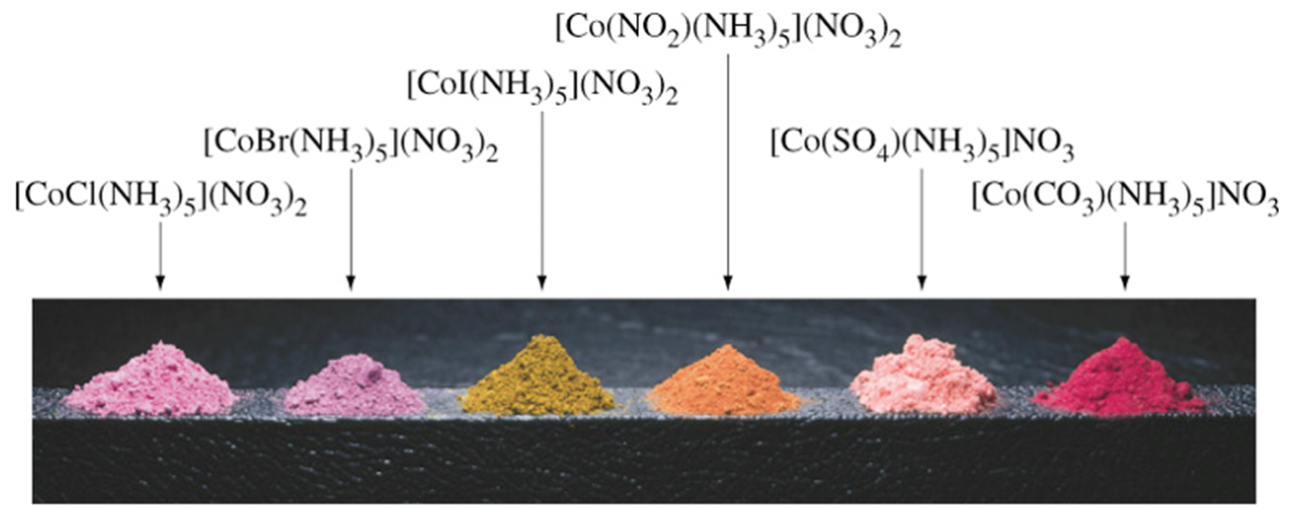
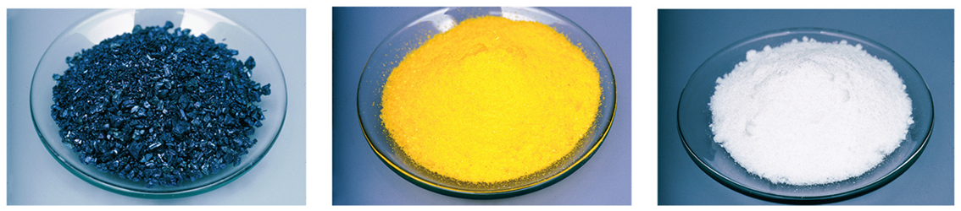
Is the Colour Difference Between CT Bands and
d-d Transitions Perceptible?
Colours due to d-d transitions
Colours due to LMCT (for KMnO₄ and K₂CrO₄)
KMnO₄
K₂CrO₄
KClO₄ (no suitable energy
d-orbitals for LMCT)

Slide 5
Ligand to Metal Charge Transfer
These involve excitation of an electron from a ligand-based orbital into a d-orbital
visible light
This is always possible but LMCT transitions are usually in the ultraviolet
They occur in the visible or near-ultraviolet if
metal is easily reduced (for example metal in high oxidation state)
ligand is easily oxidized
If they occur in the visible or near-ultraviolet, they are much more intense than ‘d-d’ bands and the latter will not be seen
Notes:
Very important equation - one that you need to remember
surely this should depend on the gas ? … No, as we’ll see soon

Slide 6
Ligand to Metal Charge Transfer
They occur in the visible or near-ultraviolet if metal is easily reduced (for example metal in high oxidation state)
TiO₂
VO₄³⁻
CrO₄²⁻
MnO₄⁻
Ti⁴⁺
V⁵⁺
Cr⁶⁺
Mn⁷⁺
d⁰
in far UV
~39500 cm⁻¹
~22200 cm⁻¹
~19000 cm⁻¹
white
white
yellow
purple
more easily reduced
Notes:
Very important equation - one that you need to remember
surely this should depend on the gas ? … No, as we’ll see soon

Slide 7
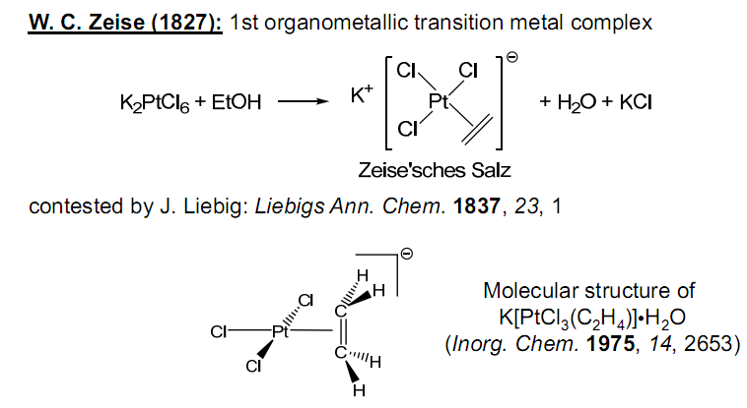
Organometallic Compounds
An Organometallic Complex contains at least one M—C bond
Includes ligands: CO, NO, N₂, PR₃, H₂
Both σ and π bonding between M and C occur
History
Zeise’s Salt synthesized in 1827 = K[Pt(C₂H₄)Cl₃] • H₂O
Confirmed to have H₂C=CH₂ as a ligand in 1868
Timeline:
1827: Friction match: John Walker
1827: Fountain-pen : Petrache Poenaru
1827 - Georg Ohm: Ohm's law (Electricity)
1827 - Amedeo Avogadro: Avogadro's law (Gas laws)
1828 - Friedrich Wöhler synthesized urea, destroying vitalism
1829: Steam locomotive: George Stephenson

Slide 8
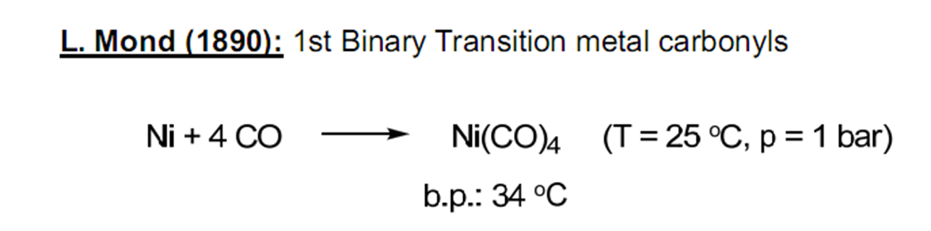
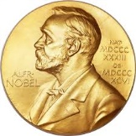
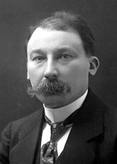
Organometallic Compounds
Ni(CO)₄ synthesized in 1890 (Ludwig Mond of Brunner Mond & Co.)
1893: Alfred Werner develops the modern ideas of coordination chemistry
Grignard Reagents (XMgR) synthesized about 1900
Accidentally produced while trying to make other compounds
Utility to organic synthesis recognized early on

Slide 9
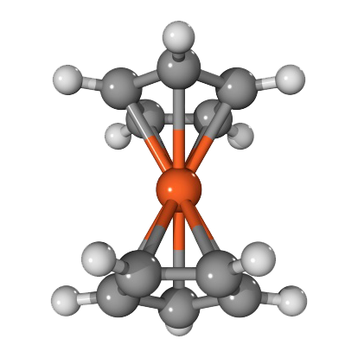
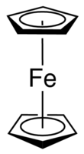
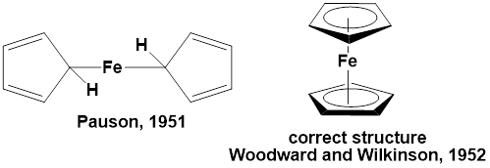
Organometallic Compounds
Ferrocene synthesized in 1951
Keally, Pauson, and Miller report the synthesis
Wilkinson and Woodward report the correct structure
Modern Organometallic Chemistry Begins After
this Discovery

Slide 10
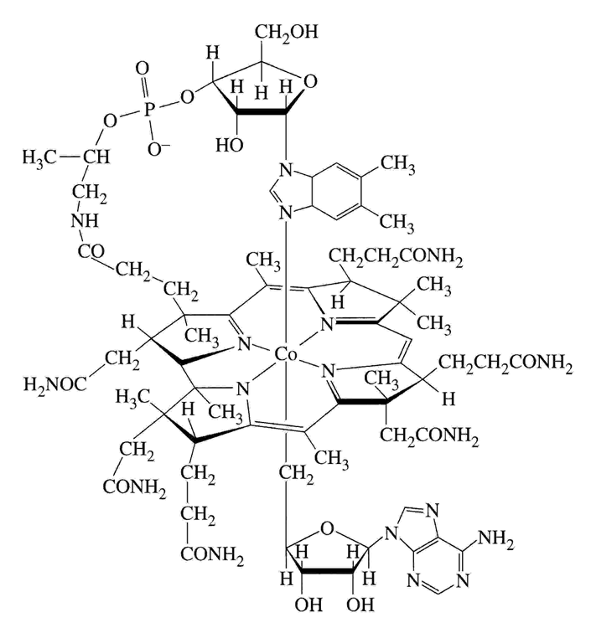
Organometallic Compounds in Nature
Organometallic chemistry has really been around for millions of years
a) Naturally occurring cobalimins contain Co—C bonds
b) Vitamin B₁₂

Slide 11
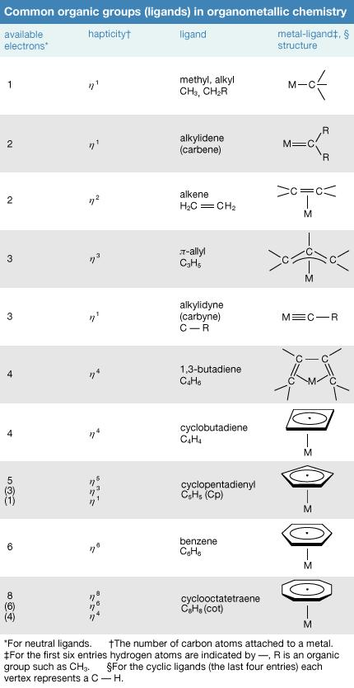
Common Organic Ligands
Carbon Monoxide (CO) is also an important ligand

Slide 12
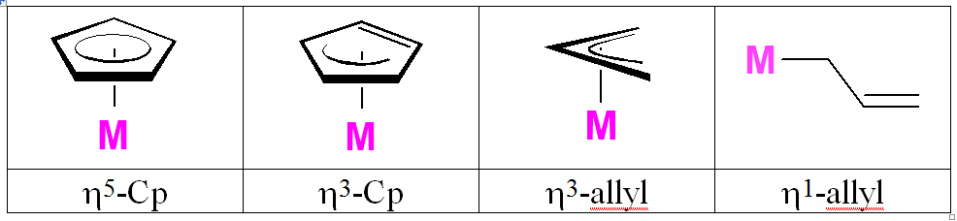
Terminology: Hapticity
η^{x}
“eta-x” was originally developed to indicate how many contiguous donor atoms of a π-system were coordinated to a metal center. Hapticity is another word used to describe the bonding mode of a ligand to a metal center. An η⁵-cyclopentadienyl ligand, for example, has all five carbons of the ring bonding to the transition metal center.
η^{x} values for all-carbon based ligands where the x value is odd usually indicate anionic carbon ligands (e.g., η⁵-Cp, η¹-CH₃, η¹-allyl or η³-allyl, η¹-CH=CH₂). The # of electrons donated (ionic method of electron counting) by the ligand is usually equal to x + 1. Even η^{x} values usually indicate neutral carbon π-system ligands (e.g., η⁶-C₆H₆, η²-CH₂=CH₂, η4-butadiene, η⁴-cyclooctadiene). The # of electrons donated by the ligand in the even (neutral) case is usually just equal to x.

Slide 13
Electron Counting: The 18 Electron Rule
Electron counting is an important tool to judge whether a given compound is
stable or not.
You are familiar with the octet rule for the second row elements. The 18 electron
rule is analogous formulation for transition elements (with many exceptions!).
For thermodynamically stable complexes, the number of ligands attached to a metal will be such that the sum of the number of electron donated by the ligands plus the valence electrons on the metal will be 18.
Why 18? It is the maximum number of electrons that can be accommodated by
One {ns}, three {np}, and five {(n-1)d} orbitals.
Structures which have this preferred count are called electron-precise.
Structures which have less than 18 electrons are termed as “coordinatively unsaturated” (they have room for more ligand(s))

Slide 14
Applicability of the 18 Electron Rule
For early transition metals, 18-e is often unattainable for steric reasons
The required number of ligands would not fit.
For later transition metals, 16-e is often quite stable
In particular for square-planar d⁸ complexes.
While there are many exceptions, we will focus on systems where
the 18 electron rule can be applied to understand structure/reactivity.
How to count electrons?

Slide 15
Methods for Counting Electrons
First method is called “ionic method” which considers charges on the metal ion and ligands in order to calculate the number of electrons.
Second method is called “neutral atom method”.
We will follow only the ionic method to avoid any confusion
Determine the oxidation state of the transition metal center(s) and the metal centers resulting d-electron count. To do this one must:
a) note any overall charge on the metal complex
b) know the charges of the ligands bound to the metal center (ionic ligand method)
c) know the number of electrons being donated to the metal center from each ligand (ionic ligand method)
Add up the electron counts for the metal center and ligands.

Slide 16
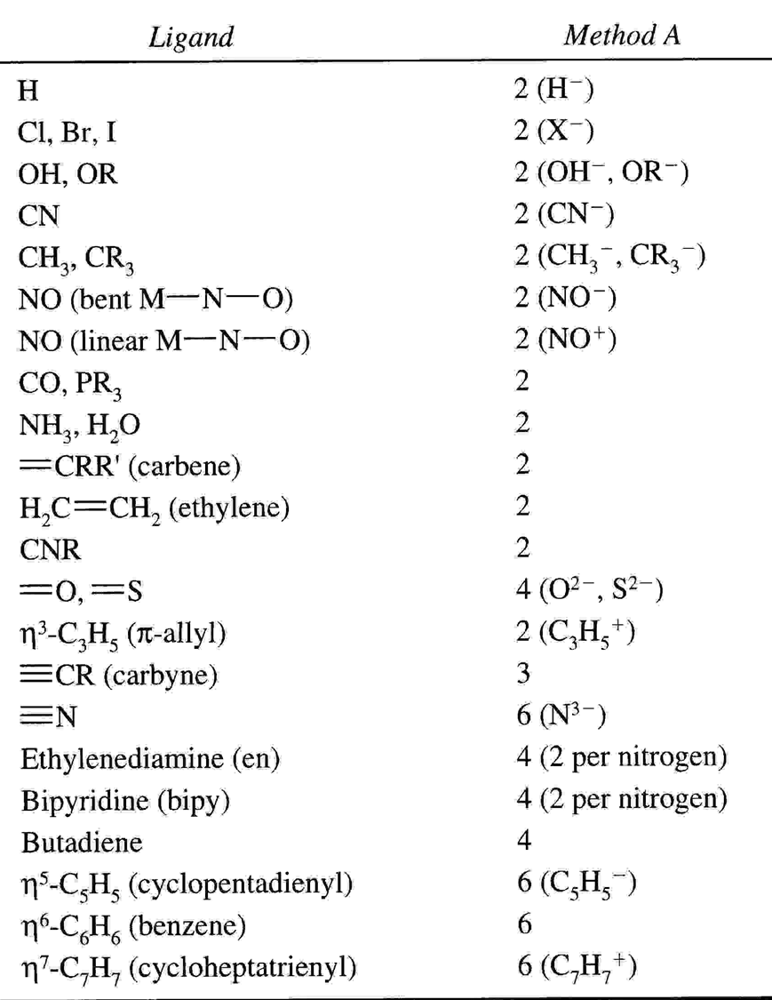
Common Ligands and Electrons Contributed
Electron Counting
a) Common organometallic ligands are assigned an electron count and charge; those that are commonly ions are treated as such
b) The overall charge on the complex must equal the total charge on ligands plus the charge on the metal; this helps determine d-electron count of metal
c) Add up all electrons from metal d orbitals and ligands to find total e- count

Slide 17
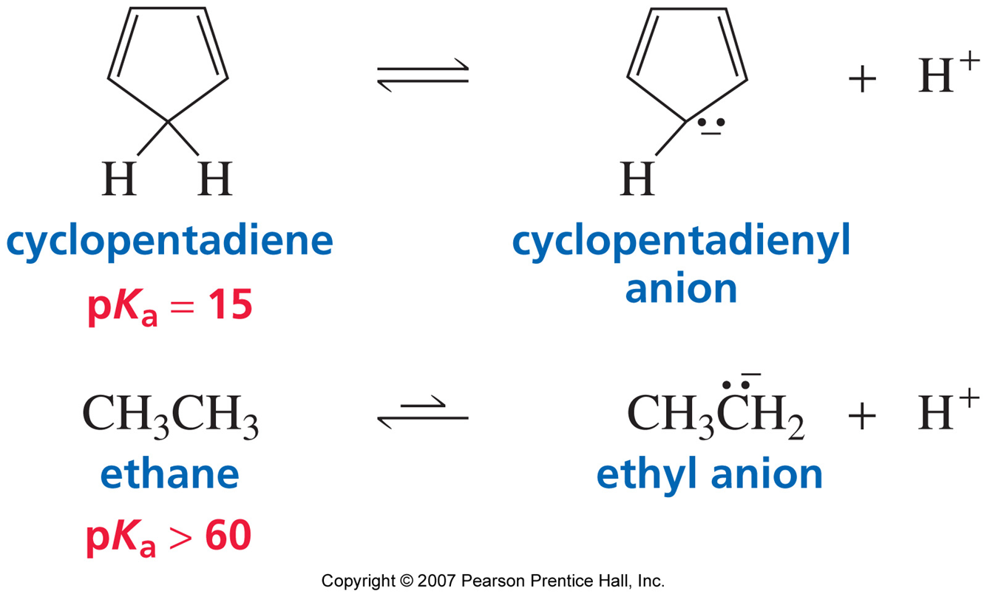
Varying Hapticity = Varying Electron Contribution
Consider the cyclopentadienyl anion.
How do we get the cyclopentadienyl anion? How to understand its structure?

Slide 18
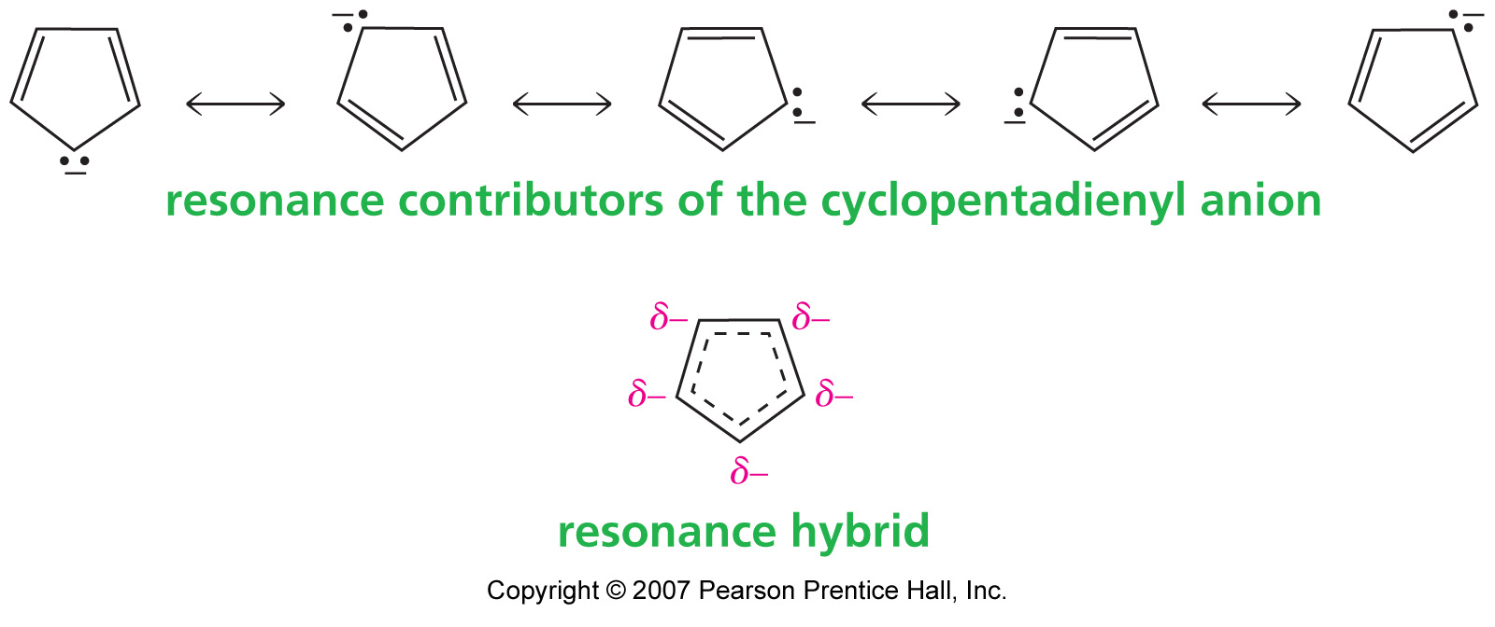
Varying Hapticity: Cyclopentadienyl Anion
Why is the pK_{a} of cyclopentadiene so much lower than that of ethane?
The conjugate base is aromatic

Slide 19
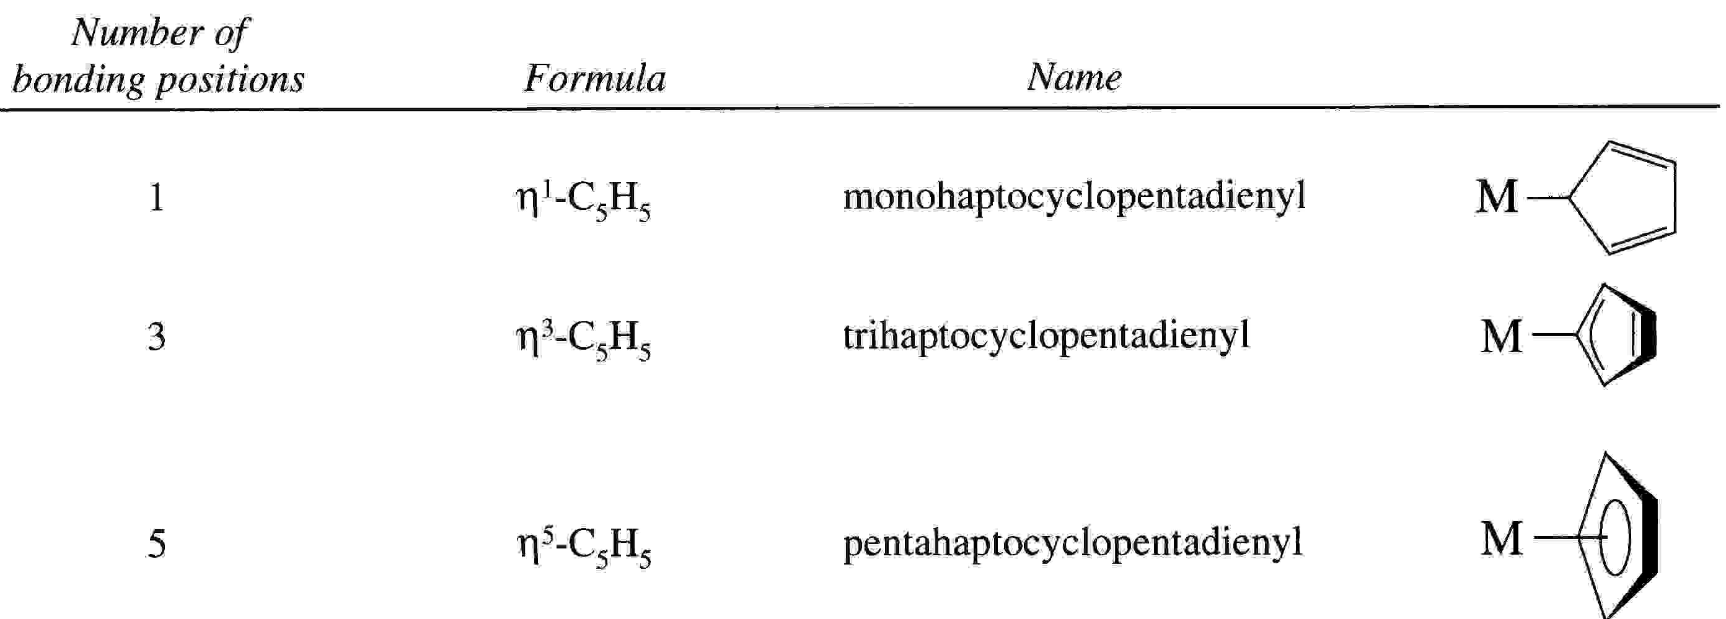
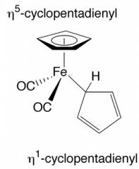
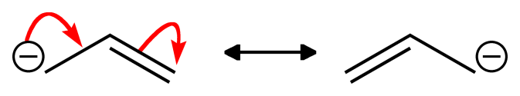
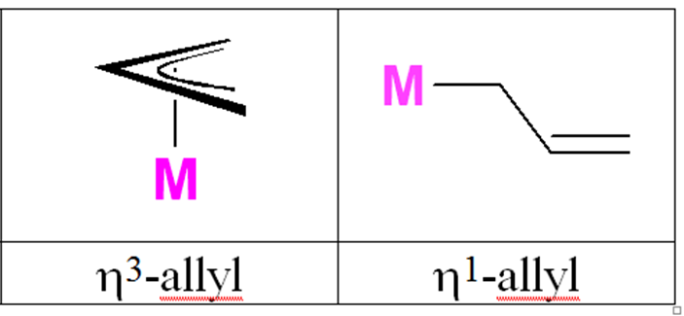
Varying Hapticity = Varying Electron Contribution
2 electron donor
4 electron donor
6 electron donor
The allyl anion has similar attributes
A molecule can have the
Same ligand in different
hapticities.
4 electron donor
2 electron donor

Slide 20
Ligands, Charges and Number of Electrons Donated
Ionic Method of electron-counting
Cationic 2e- donor: NO⁺ (nitrosyl)
Neutral 2e- donors: PR₃ (phosphines), CO (carbonyl), R₂C=CR₂ (alkenes), RC≡CR (alkynes, can also donate 4 e-), N≡CR (nitriles)
Anionic 2e- donors: Cl⁻ (chloride), Br⁻ (bromide), I⁻ (iodide), CH₃⁻ (methyl), CR₃⁻ (alkyl), Ph⁻ (phenyl), H⁻ (hydride) The following can also donate 4 e- if needed, but initially count them as 2e- donors (unless they are acting as bridging ligands): OR⁻ (alkoxide), SR⁻ (thiolate), NR₂⁻ (inorganic amide), PR₂⁻ (phosphide)
Anionic 4e- donors: C₃H₅⁻ (allyl), O²⁻ (oxide), S²⁻ (sulfide), NR²⁻ (imido), CR₂²⁻ (alkylidene) and from the previous list: OR⁻ (alkoxide), SR⁻ (thiolate), NR₂⁻ (inorganic amide), PR₂⁻
Anionic 6e- donors: Cp⁻ (cyclopentadienyl), N³⁻ (nitride)

Slide 21
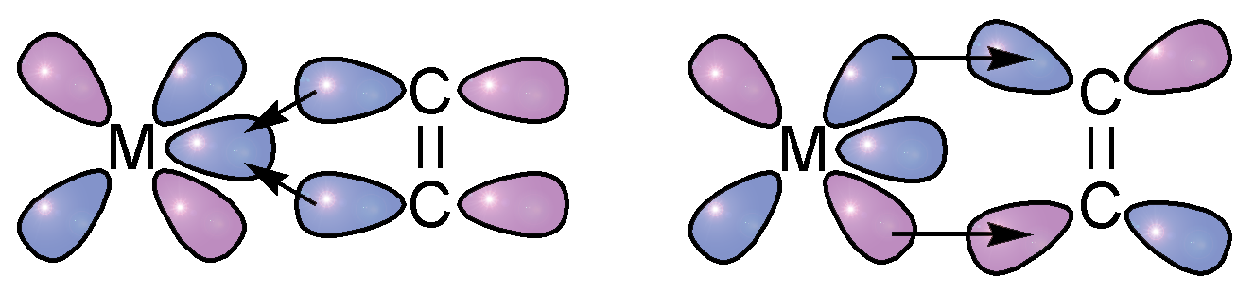
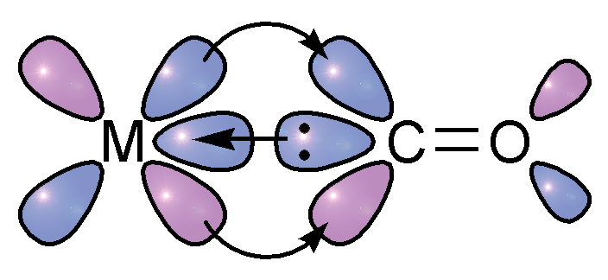
Dewar-Chatt-Duncanson Model for Metal-Alkene Bonding
σ-component:
C-C π → empty metal orbital
π-component:
occupied metal d → empty C-C π*
Note the similarity to CO ligands...
σ-component: donation of C lone pair
π-component: backbonding into CO π*
3I3-7
Notes:
Point out that C-C pi bond is really just one orbital, not two p lobes as shown here

Slide 22
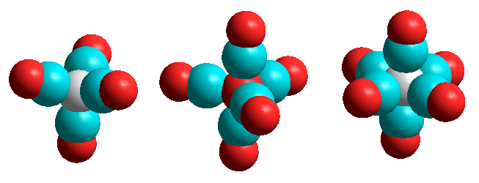
Metal-Carbonyl Complexes
The carbonyl ligand forms a huge number of complexes with metal ions, most commonly in low oxidation states, where it binds to the metal through its C-donor, as in the complexes below, where all the metal ions are zero-valent:
[Ni(CO)₄] [Fe(CO)₅] [Cr(CO)₆]

Slide 23
Metal-Carbonyl Complexes: 18 Electron Rule
Why in the above complexes Ni(0) has four C≡O groups attached to it, Fe(0) five C≡O, and Cr(0) six C≡O?
The eighteen electron rule allows us to explain this observation.
The charge on the complexes is zero. Since CO is a neutral molecule, the metals are in the zero oxidation state.
[Ni(CO)₄] [Fe(CO)₅] [Cr(CO)₆]
Ni(0) = d¹⁰ Fe(0) = d⁸ Cr(0) = d⁶
4 x CO = 8 5 x CO =10 6 x CO = 12
18 e 18e 18e

Slide 24
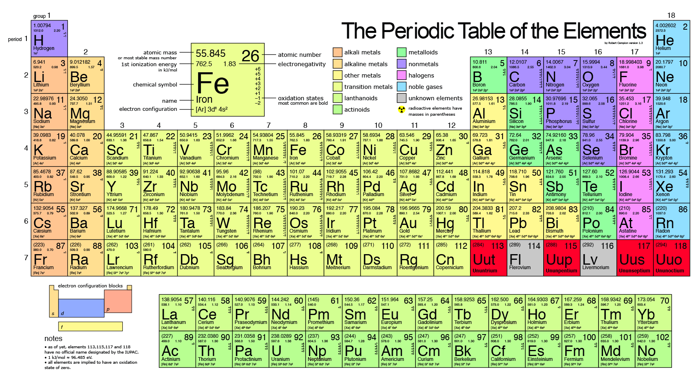
Example: A Simple Case
1) There is no overall charge on the complex
2) There is one anionic ligand (CH₃⁻, methyl group)
3) The Re metal atom must have a +1 charge to compensate for the one negatively charged ligand. So the Re is the in the +1 oxidation state. We denote this three different ways: Re(+1), Re(I), or Re^{I}.
Re(+1) | d⁶
2 PR₃ | 4e-
2 CO | 4e-
CH₃⁻ | 2e-
CH₂=CH₂ | 2e-
Total: | 18e-

Slide 25
Example: Simple Case with Somewhat Unusual Ligand
1) There is a +2 charge on the complex
2) The CNCH₃ (methyl isocyanide) ligand is neutral, but lets check the Lewis Dot structure to make sure that is correct:
3) Because there is a +2 charge on the complex and all neutral ligands present, the Mo has a +2 charge & oxidation state.
Mo(+2) | d⁴
7 CNCH₃ | 14e-
Total: | 18e-

Slide 26
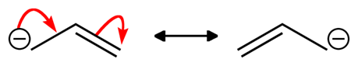
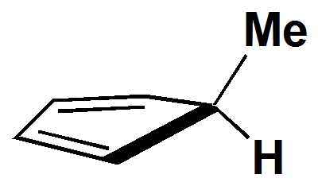
Example: Somewhat Tricky!
1) There is no overall charge on the complex
2) There is one anionic ligand (C₃H₅⁻, allyl)
3) The top ligand is NOT a MeCp⁻! It is a neutral diene that has a H attached to the methyl-substituted ring carbon. This is a neutral 4e- donor.
4) Because the complex is neutral and there is one anionic ligand present, the Rh atom must have a +1 charge to compensate for the one negatively charged ligand. So the Rh atom is in the +1 oxidation state.
Rh(+1) | d⁸
PR₃ | 2e-
η⁴-C₅H₅Me | 4e-
η³-C₃H₅⁻ | 4e-
Total: | 18e-

Slide 27
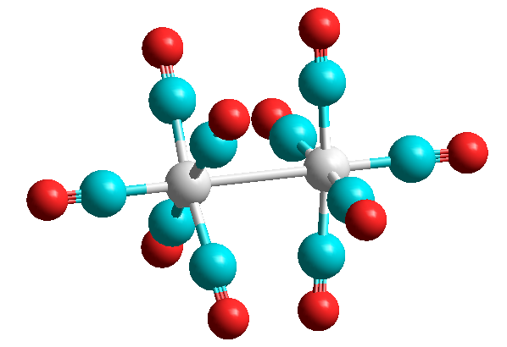
18 Electron Rule Explains Some Observations
The compound Mn₂(CO)₁₀ exists but Mn(CO)₅ does not.
A species such as [Mn(CO)₅] would have only 17 e.
Each Mn contributes one electron to the valence shell of the other Mn, giving the metal-metal bonded species [(CO)₅Mn-Mn(CO)₅]. To check on the 18e rule, we look at one metal at a time:
Mn-Mn
bond
Mn(0) = d⁷
5 C≡O = 10
Mn-Mn = 1
18 e
Mn
Mn
[Mn₂(CO)₁₀]

Slide 28
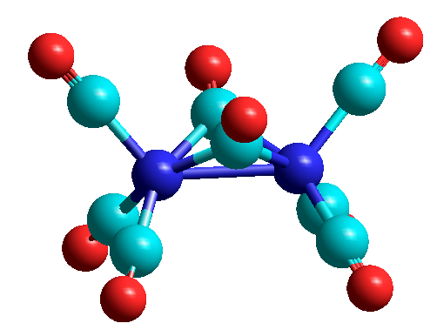
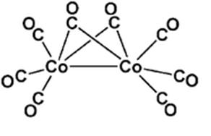
Bridging Carbonyl Ligands
bridging
carbonyls
Carbonyls may form bridges between two metals, where they donate one electron to each metal in working out the 18 electron rule.
In [Co₂(CO)₈] , each Co has three terminal CO’s, two bridging CO’s, and a Co-Co bond:
Co(0) = d⁹
3 CO’s = 6
2 bridge CO’s = 2
Co-Co bond = 1
18 e
Co
Co
Co-Co
bond
[Co₂(CO)₈]

Slide 29
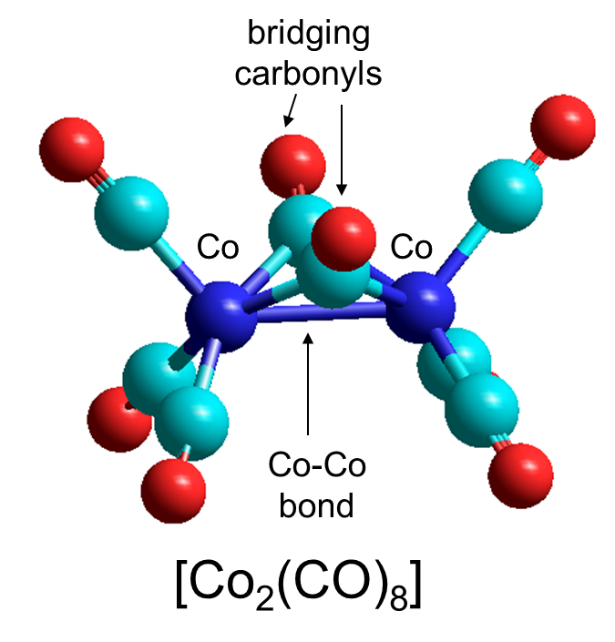
Terminolgy for Bridging Ligands
μ_{x}
“mu-x” is the nomenclature used to indicate the presence of a bridging ligand between two or more metal centers. The x refers to the number of metal centers being bridged by the ligand. Usually most authors omit x = 2 and just use μ to indicate that the ligand is bridging the simplest case of two metals.
(CO)₃Co(μ-CO)₂Co(CO)₃

Slide 30
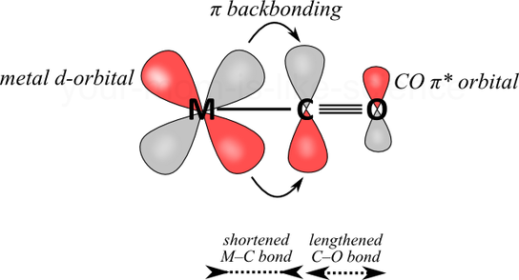
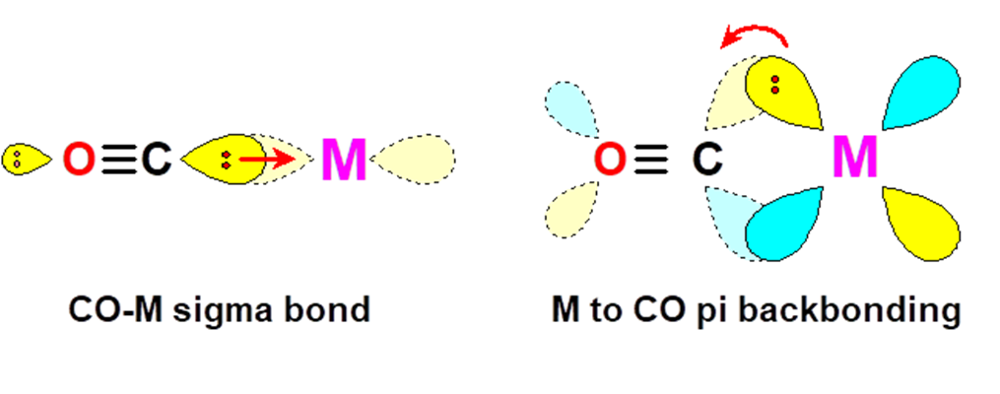
Bonding in Metal Carbonyls
M-CO:
σ-donation strengthens M-C bond
π-back donation strengthens M-C bond and weakens C≡O
As back bonding would increase, we would expect the C=O bond
strength to decrease

Slide 31
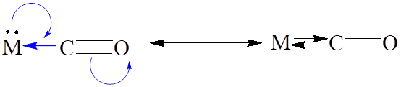
Infrared (IR) Spectroscopy and C=O Bond Strength
IR spectra provides information about the stretching frequency of a bond. Recall that the stronger a bond gets, the higher its stretching frequency.
The υ_{CO} stretching frequency of the coordinated CO is very informative as to the nature of the bonding.
Thus, the more important the M=C=O (C=O is a double bond) canonical structure, the lower the υ_{CO} stretching frequency as compared to the M-C≡O structure (C≡O is a triple bond): (Note: υ_{CO} for free CO is 2041 cm⁻¹)
[Ti(CO)₆]²⁻ [V(CO)₆]⁻ [Cr(CO)₆] [Mn(CO)₆]⁺ [Fe(CO)₆]²⁺
υ_{CO} 1748 1858 1984 2094 2204 cm⁻¹
increasing M=C double
bonding
decreasing M=C double
bonding

Slide 32
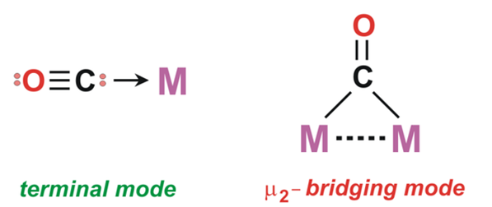
IR Spectra: Bridging vs Terminal Carbonyls
Bridging CO groups can be regarded as having a double bond C=O group, as compared to a terminal C≡O, which is more like a triple bond:
M
M-C≡O C=O
M
One can thus use the CO stretching
frequencies around 1700-2200 cm⁻¹ to
detect the presence of bridging CO groups.
the C=O group
in a bridging
carbonyl is more
like the C=O in
a ketone, which
typically has
υ_{C=O} = 1750 cm⁻¹
~ triple bond
~ double bond
terminal carbonyl bridging carbonyl
(~ 1850-2125 cm⁻¹) (~1700-1860 cm⁻¹)

Slide 33
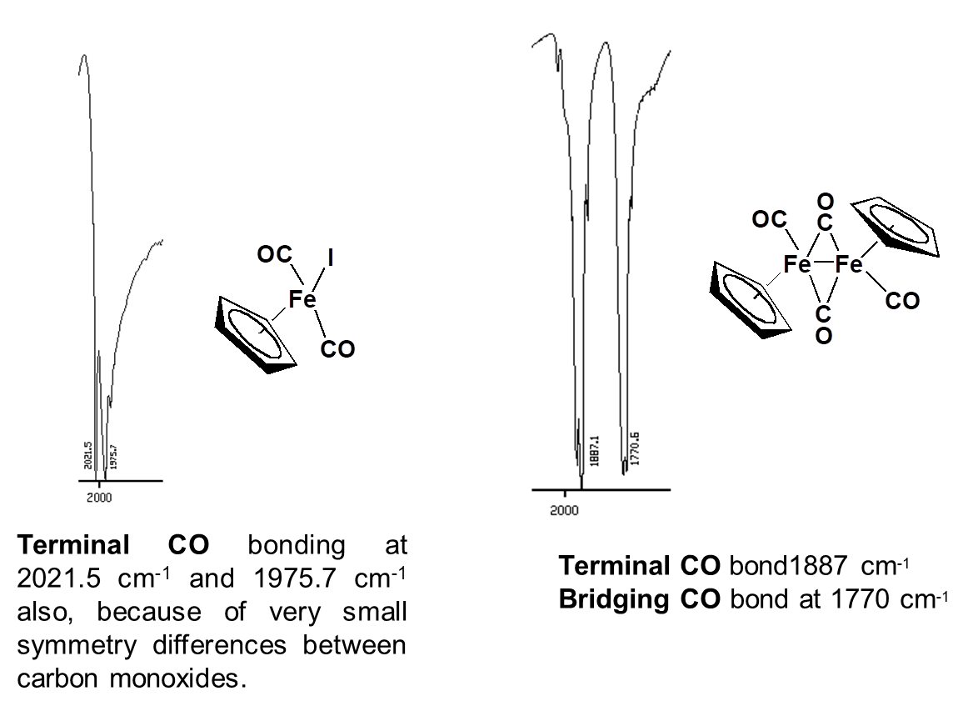
Bridging vs Terminal CO

